Slide 1
Inner Join
Data Manipulation Language

Slide 2
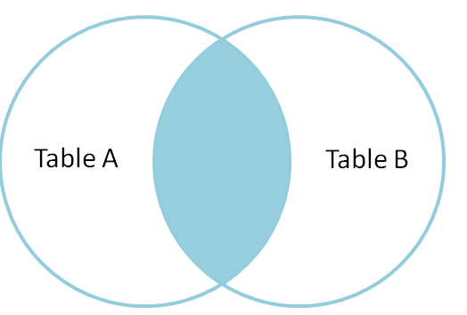
Inner Join – Two tables
Return the set of records that match in both Table A and Table B
Can be natural, equi or non-equi join.
Difference is the columns you use to join and conditions you place on the join.
Equi joins depend on referential integrity (even if columns named differently) and equality
Non-Equi joins don’t.

Slide 3
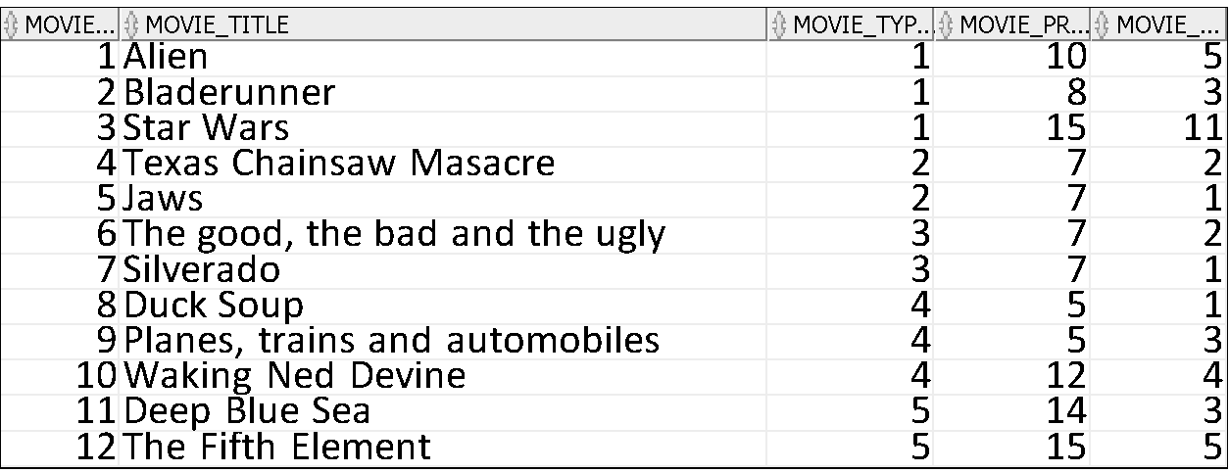
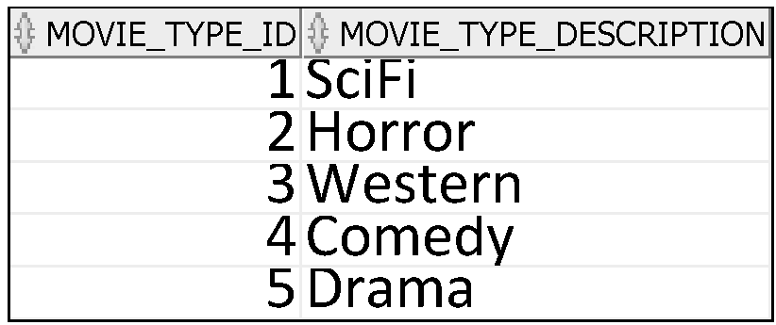
Find the titles of all movies and return the description of the type
Select movie_title, movie_type_description from mm_movie M
Join mm_movie_type T on (m.movie_type_id=t.movie_type_id);
The corresponding
SQL query.
DB (2 tables)
MM_MOVIE_TYPE
MM_MOVIE
This specifies how the tables
are to be joined together.
This query requires information from both the mm_movie and the mm_movie_type tables
To answer this query, a JOIN operation needs to be performed.

Slide 4
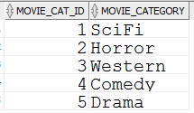
Find the titles of all movies and return the description of the type
Select movie_title, movie_type_description from mm_movie M
Join mm_movie_type T on (m.movie_type_id=t.movie_type_id);
Overview:
A JOIN operation works as follows:
for each row in table MM_MOVIE
{
For each row in MM_MOVIE_TYPE
{
if match found with on join columns
{
if match on where conditions {
create entry in output table}
}
}
}
MM_MOVIE
This specifies how the tables
are to be joined together
MM_MOVIE_TYPE

Slide 5
Find the titles of all movies and return the description of the type
Select movie_title, movie_type_description from mm_movie M
Join mm_movie_type T on (m.movie_type_id=t.movie_type_id);
DBMS
M.movie_type_id=1
T.movie_type_id=1
Match
MM_MOVIE
Result
MOVIE_TITLE | MOVIE_TYPE_DESCRIPTION
Alien | SciFi
MM_MOVIE_TYPE

Slide 6
Find the titles of all movies and return the description of the type
Select movie_title, movie_type_description from mm_movie M
Join mm_movie_type T on (m.movie_type_id=t.movie_type_id);
DBMS
M.movie_type_id=1
T.movie_type_id=1
Match
MM_MOVIE
Result
MOVIE_TITLE | MOVIE_TYPE_DESCRIPTION
Alien | SciFi
BladeRunner | SciFi
MM_MOVIE_TYPE

Slide 7
Find the titles of all movies and return the description of the type
Select movie_title, movie_type_description from mm_movie M
Join mm_movie_type T using (movie_type_id)
DBMS
M.movie_type_id=1
T.movie_type_id=1
Match
MM_MOVIE
Result
MOVIE_TITLE | MOVIE_TYPE_DESCRIPTION
Alien | SciFi
BladeRunner | SciFi
Star Wars | SciFi
MM_MOVIE_TYPE

Slide 8
Find the titles of all movies and return the description of the type
Select movie_title, movie_type_description from mm_movie M
Join mm_movie_type T using (movie_type_id)
DBMS
M.movie_type_id=2
T.movie_type_id=1
No Match
MM_MOVIE
Result
MOVIE_TITLE | movie_type_description
Alien | SciFi
BladeRunner | SciFi
Star Wars | SciFi
MM_MOVIE_TYPE

Slide 9
Find the titles of all movies and return the description of the type
Select movie_title, movie_type_description from mm_movie M
Join mm_movie_type T on (m.movie_type_id=t.movie_type_id);
DBMS
M.movie_type_id=2
T.movie_type_id=2
Match
Result
MM_MOVIE
MOVIE_TITLE | movie_type_description
Alien | SciFi
BladeRunner | SciFi
Star Wars | SciFi
Texas Chainsaw Massacre | Horror
MM_MOVIE_TYPE

Slide 10
Find the titles of all movies and return the description of the type
Select movie_title, movie_type_description from mm_movie M
Join mm_movie_type T using (movie_type_id)
DBMS
M.movie_type_id=2
T.movie_type_id=1
No Match
MM_MOVIE
Result
MOVIE_TITLE | movie_type_description
Alien | SciFi
BladeRunner | SciFi
Star Wars | SciFi
Texas Chainsaw Massacre | Horror
MM_MOVIE_TYPE

Slide 11
Find the titles of all movies and return the description of the type
Select movie_title, movie_type_description from mm_movie M
Join mm_movie_type T using (movie_type_id)
DBMS
M.movie_type_id=2
T.movie_type_id=2
Match
Result
MOVIE_TITLE | movie_type_description
Alien | SciFi
BladeRunner | SciFi
Star Wars | SciFi
Texas Chainsaw Massacre | Horror
Jaws | Horror
MM_MOVIE
MM_MOVIE_TYPE

Slide 12
Find the titles of all movies and return the description of the type
Select movie_title, movie_type_description from mm_movie M
Join mm_movie_type T using (movie_type_id)
DBMS
M.movie_type_id=2
T.movie_type_id=1
No Match
MM_MOVIE
Result
MOVIE_TITLE | movie_type_description
Alien | SciFi
BladeRunner | SciFi
Star Wars | SciFi
Texas Chainsaw Massacre | Horror
MM_MOVIE_TYPE

Slide 13
Find the titles of all movies and return the description of the type
Select movie_title, movie_type_description from mm_movie M
Join mm_movie_type T using (movie_type_id)
DBMS
M.movie_type_id=2
T.movie_type_id=2
Match
Result
MOVIE_TITLE | movie_type_description
Alien | SciFi
BladeRunner | SciFi
Star Wars | SciFi
Texas Chainsaw Massacre | Horror
Jaws | Horror
MM_MOVIE
MM_MOVIE_TYPE

Slide 14
And So On……
Until
All Rows in MM_MOVIE have been reviewed
At which point the output table will be presented….

Slide 15
Summary of Q3:
Result of SQL query requires
information from two tables
a JOIN operation is necessary
Joins are EXPENSIVE operations.

Slide 16
Find the titles of all movies and return the description of the type
Select movie_title, movie_type_description from mm_movie M
Join mm_movie_type T
Using (movie_type_id)
This will achieve the same result as the Join On
BUT it will only work if column has the same name in both tables

Slide 17
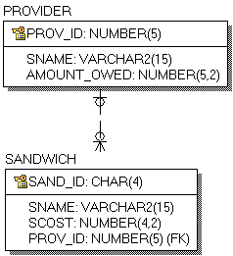
Small Sandwich Retailer
Sell Sandwiches to Customers (name, cost, the ID of the company that sells them to us)
For each provider we have the ID, the name and the amount we owe them.
SQL is available in L4-SandwichProvider.sql in Webcourses

Slide 18
Small Sandwich Retailer
What data should be returned by joining the two tables?
Sandwich Table Contents
SAND_ID | SNAME | SCOST | PROV_ID
BLTW | BLT on White | €3.50 | 23
BLTB | BLT on Brown | €3.50 | 23
JMBO | Jumbo Sandwich | €6.50 | 42
Suppose we want to execute a query with join these two tables?
What different types of join can we do?

Slide 19
Cartesian Product or Cross Join
SELECT * FROM PROVIDER, SANDWICH;

Slide 20
Cartesian Product or Cross Join
SELECT * FROM PROVIDER, SANDWICH;
Every single row in sandwich will be paired with every single row in provided regardless of whether the provider ID matches
PRODUCT
Set of ordered pairs

Slide 21
Cartesian Product or Cross Join
SELECT * FROM PROVIDER CROSS JOIN SANDWICH;
Every single row in sandwich will be paired with every single row in provided regardless of whether the provider ID matches
PRODUCT
Set of ordered pairs

Slide 22
Natural Join
“NATURAL” means equi-join for each pair of attributes with the same name
Will match on all columns which have the same name and datatype which have the same value in both tabls
Which columns are going to be considered?
Select * from sandwich natural join provider;

Slide 23
Natural Join
The natural join tried to join on prov_id and sname
There are no rows that have the same entry in both columns i.e. no row in sandwich that has prov_id and sname matching a row in provider that has same values for these columns.
Select * from sandwich natural join provider;
Result
No matches found!
Sandwich Table Contents
SAND_ID | SNAME | SCOST | PROV_ID
BLTW | BLT on White | €3.50 | 23
BLTB | BLT on Brown | €3.50 | 23
JMBO | Jumbo Sandwich | €6.50 | 42

Slide 24
Natural Join
The natural join tried to join on prov_id and sname
There are no rows that have the same entry in both columns i.e. no row in sandwich that has prov_id and sname matching a row in provider that has same values for these columns.
Select * from sandwich natural join provider;
No matches found!
Why Not?
Yes there is a match on SNAME but for that row the value of PROV_ID is different (42 does not match with 22)
Sandwich Table Contents
SAND_ID | SNAME | SCOST | PROV_ID
BLTW | BLT on White | €3.50 | 23
BLTB | BLT on Brown | €3.50 | 23
JMBO | Jumbo Sandwich | €6.50 | 42

Slide 25
Join USING (Inner Join, Equi Join)
Columns have same name and datatype in both tables
Select *
from sandwich
join provider using (prov_id);
PROV_ID | SAND_ID | SNAME | SCOST | SNAME_1 | AMOUNT _OWED
23 | BLTW | BLT on White | €3.50 | O'Brien's | €540.00
23 | BLTB | BLT on Brown | €3.50 | O'Brien's | €540.00
42 | JMBO | Jumbo Sandwich | €6.50 | Spar | €84.57

Slide 26
Join ON (Inner Join, Equi Join)
Suppose we introduce a second sandwich table, corporate sandwich.
We charge a little bit less for some of them them because we do bulk orders.
Has same basic structure but different column names.
Csandwich=(Csand_id,Csname, Cscost,Cprov_id)
CSandwich Table Contents
CSAND_ID | CSNAME | CSCOST | CPROV_ID
BLTW | BLT on White | €2.50 | 23
BLTB | BLT on Brown | €2.50 | 23
JMBO | Jumbo Sandwich | €6.50 | 42

Slide 27
Join ON (Inner Join, Equi Join)
Suppose we want to join between this Csandwich table and the Provider Table?
There is no common column between these tables.
The column we are interested in is CPROV_ID in the Csandwich table and PROV_ID in the Provider table
CSandwich Table Contents
CSAND_ID | CSNAME | CSCOST | CPROV_ID
BLTW | BLT on White | €3.50 | 23
BLTB | BLT on Brown | €3.50 | 23
JMBO | Jumbo Sandwich | €6.50 | 42

Slide 28
Join ON (Inner Join, Equi Join) No common column
Can’t say using because names of columns are different
So use on and identify columns join should use
Select Csname, Sname
from Csandwich
join provider on (cprov_id = prov_id);

Slide 29
Non-Equi Join
The SQL NON EQUI JOIN uses comparison operator instead of the equal sign like >, <, >=, <= along with conditions.
SELECT *
FROM table_name1
JOIN table 2 ON table_name1.column [> | < | >= | <= ] table_name2.column;

Slide 30
Join Non Equi Join
Suppose we can to join the sandwich table to the corporate sandwich table
Has same basic structure but different column names
No referential link
Returns every regular sandwich that costs more than any corporater sandwich
Select s.sname, p.csname, s.scost, p.cscost
from sandwich s
join csandwich p on (s.scost > p.cscost);

Slide 31
Join Non Equi Join
Select s.sname, p.csname, s.scost, p.cscost
from sandwich s
join csandwich p on (s.scost < p.cscost);
Output
s.Sname | p.Csname | S.Scost | C.cscost
BLT on White | BLT on White | €3.50 | €2.50
BLT on Brown | BLT on Brown | €3.50 | €2.50

Slide 32
Joining Tables Using SQL:1999 Syntax
Use a join to query data from more than one table:
SELECT table1.column, table2.column
FROM table1
[NATURAL JOIN table2] |
[JOIN table2 USING (column_name)] |
[JOIN table2
ON (table1.column_name = table2.column_name)]|
[LEFT|RIGHT|FULL OUTER JOIN table2
ON (table1.column_name = table2.column_name)]|
[CROSS JOIN table2];
An instruction to a database to combine data from more than one table.
Notes:
Defining Joins
In the syntax:
table1.column denotes the table and column from which data is retrieved
NATURAL JOIN joins two tables based on the same column name
JOIN table USING column_name performs an equijoin based on the column name
JOIN table ON table1.column_name performs an equijoin based on the condition in the ON clause, = table2.column_name
LEFT/RIGHT/FULL OUTER is used to perform outer joins
CROSS JOIN returns a Cartesian product from the two tables
For more information, see “SELECT” in Oracle SQL Reference.

Slide 33
Joining Tables Using SQL:1999 Syntax
Use a join to query data from more than one table:
SELECT table1.column, table2.column
FROM table1
[NATURAL JOIN table2] |
[JOIN table2 USING (column_name)] |
[JOIN table2
ON (table1.column_name = table2.column_name)]|
[LEFT|RIGHT|FULL OUTER JOIN table2
ON (table1.column_name = table2.column_name)]|
[CROSS JOIN table2];
NATURAL JOIN joins two tables based on the same column name
You don’t specify the name of the column, Oracle will match on ALL columns that have the same name in both tables
Notes:
Defining Joins
In the syntax:
table1.column denotes the table and column from which data is retrieved
NATURAL JOIN joins two tables based on the same column name
JOIN table USING column_name performs an equijoin based on the column name
JOIN table ON table1.column_name performs an equijoin based on the condition in the ON clause, = table2.column_name
LEFT/RIGHT/FULL OUTER is used to perform outer joins
CROSS JOIN returns a Cartesian product from the two tables
For more information, see “SELECT” in Oracle SQL Reference.

Slide 34
Joining Tables Using SQL:1999 Syntax
Use a join to query data from more than one table:
SELECT table1.column, table2.column
FROM table1
[NATURAL JOIN table2] |
[JOIN table2 USING (column_name)] |
[JOIN table2
ON (table1.column_name = table2.column_name)]|
[LEFT|RIGHT|FULL OUTER JOIN table2
ON (table1.column_name = table2.column_name)]|
[CROSS JOIN table2];
JOIN table USING column_name performs an equijoin based on the column name
Notes:
Defining Joins
In the syntax:
table1.column denotes the table and column from which data is retrieved
NATURAL JOIN joins two tables based on the same column name
JOIN table ON table1.column_name performs an equijoin based on the condition in the ON clause, = table2.column_name
LEFT/RIGHT/FULL OUTER is used to perform outer joins
CROSS JOIN returns a Cartesian product from the two tables
For more information, see “SELECT” in Oracle SQL Reference.

Slide 35
Joining Tables Using SQL:1999 Syntax
Use a join to query data from more than one table:
SELECT table1.column, table2.column
FROM table1
[NATURAL JOIN table2] |
[JOIN table2 USING (column_name)] |
[JOIN table2
ON (table1.column_name = table2.column_name)]|
[LEFT|RIGHT|FULL OUTER JOIN table2
ON (table1.column_name = table2.column_name)]|
[CROSS JOIN table2];
JOIN table ON table1.column_name performs an equijoin based on the condition in the ON clause, = table2.column_name
Notes:
Defining Joins
In the syntax:
table1.column denotes the table and column from which data is retrieved
NATURAL JOIN joins two tables based on the same column name
JOIN table ON table1.column_name performs an equijoin based on the condition in the ON clause, = table2.column_name
LEFT/RIGHT/FULL OUTER is used to perform outer joins
CROSS JOIN returns a Cartesian product from the two tables
For more information, see “SELECT” in Oracle SQL Reference.

Slide 36
Joining Tables Using SQL:1999 Syntax
Use a join to query data from more than one table:
SELECT table1.column, table2.column
FROM table1
[NATURAL JOIN table2] |
[JOIN table2 USING (column_name)] |
[JOIN table2
ON (table1.column_name = table2.column_name)]|
[LEFT|RIGHT|FULL OUTER JOIN table2
ON (table1.column_name = table2.column_name)]|
[CROSS JOIN table2];
LEFT/RIGHT/FULL OUTER is used to perform outer joins
i.e. to find data that exists in one table but not in another
Notes:
Defining Joins
In the syntax:
table1.column denotes the table and column from which data is retrieved
NATURAL JOIN joins two tables based on the same column name
JOIN table ON table1.column_name performs an equijoin based on the condition in the ON clause, = table2.column_name
LEFT/RIGHT/FULL OUTER is used to perform outer joins
CROSS JOIN returns a Cartesian product from the two tables
For more information, see “SELECT” in Oracle SQL Reference.

Slide 37
Joining Tables Using SQL:1999 Syntax
Use a join to query data from more than one table:
SELECT table1.column, table2.column
FROM table1
[NATURAL JOIN table2] |
[JOIN table2 USING (column_name)] |
[JOIN table2
ON (table1.column_name = table2.column_name)]|
[LEFT|RIGHT|FULL OUTER JOIN table2
ON (table1.column_name = table2.column_name)]|
[CROSS JOIN table2];
CROSS JOIN returns a Cartesian product from the two tables
Notes:
Defining Joins
In the syntax:
table1.column denotes the table and column from which data is retrieved
NATURAL JOIN joins two tables based on the same column name
JOIN table ON table1.column_name performs an equijoin based on the condition in the ON clause, = table2.column_name
LEFT/RIGHT/FULL OUTER is used to perform outer joins
CROSS JOIN returns a Cartesian product from the two tables
For more information, see “SELECT” in Oracle SQL Reference.

Slide 38
Foreign Keys

Slide 39
Our Small Library
We want to store information about
Books
Patrons
Transactions
We want to enforce referential integrity by introducing
A foreign key from Transactions to Books
A foreign key from Transactions to Patrons

Slide 40
Our Small Library
Rather than having a synthetic key on transactions we use our knowledge of the library
A book can be involved in the same type of transaction fora patron multiple times but these must be on different dates
We will use a composite key made up of three pieces of information bookid, patronid, transactiondate
We want to introduce a Transaction Type table
We will need to create a foreign key from Transactions to this new table

Slide 41
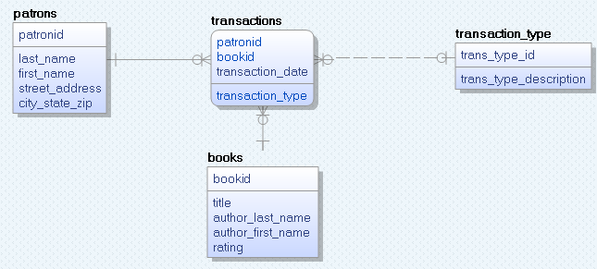
Library
books (bookid, title, author_last_name, author_first_name, rating)
patrons (patronid, last_name, first_street_address, city_state_zip)
transaction_type(
trans_type_id, trans_type_description)
transactions (patronid, bookid, transaction_date, transaction_type)
Transactions has a composite key
SQL to create this is available in
L4-Library-FK.sql

Slide 42
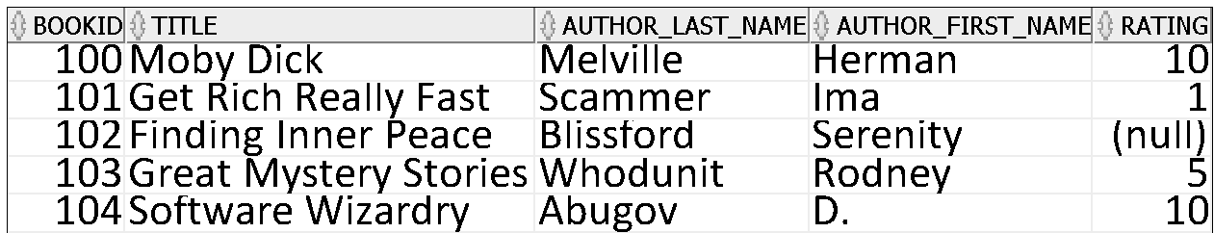
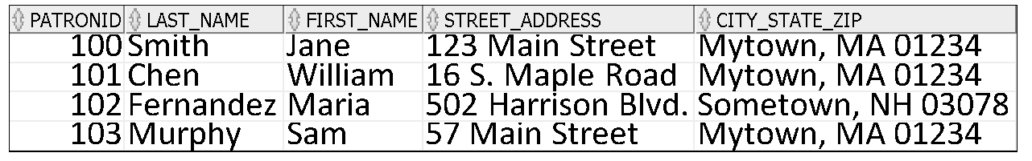
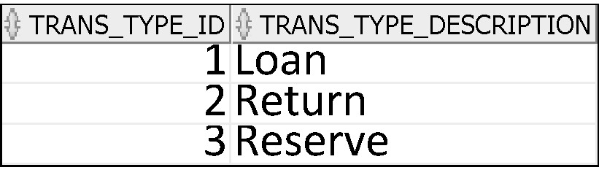
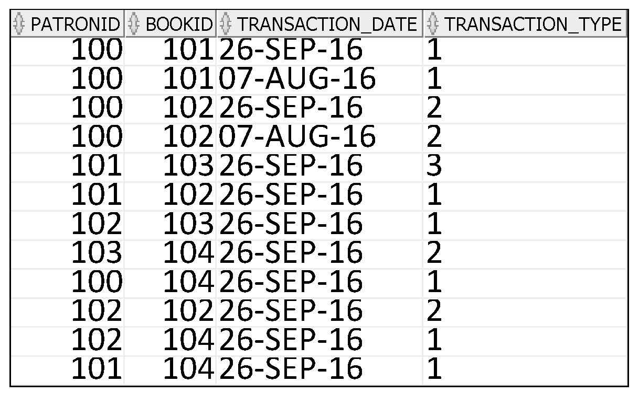
Library
Books
We’ve changed the data inserted into the transactions table slightly from Lecture 2 so that we can see the composite/compound key working.
We’ve introduced a new table transaction_type
Patrons
Transaction_Type
Transactions

Slide 43
Creating the Tables
-- Clean up from any previous tutorial actions.
DROP TABLE transactions;
DROP TABLE transaction_type;
DROP TABLE books;
DROP TABLE patrons;
Step 1: Drop the tables
We must drop them in order of dependency
First drop tables that don’t depend on the most other tables (i.e. have most foreign key relationships)
Then drop the tables that don’t have foreign keys

Slide 44
Creating the Tables
-- Create the tables needed - this time with foreign keys
CREATE TABLE books (
bookid NUMBER,
title VARCHAR2(50),
author_last_name VARCHAR2(30),
author_first_name VARCHAR2(30),
rating NUMBER,
--Create primary key constraint for the books table
constraint book_pk primary key (bookid)
);
Step 2: Create the tables
We must create them in reverse order of dependency
First create tables that don’t depend on any others (i.e. have no foreign key relationships)
Then create the tables that depend only on these

Slide 45
Creating the Tables
CREATE TABLE patrons (
patronid NUMBER ,
last_name VARCHAR2(30),
first_name VARCHAR2(30),
street_address VARCHAR2(50),
city_state_zip VARCHAR2(50),
--Create primary key constraint for the patrons table
constraint patron_pk primary key (patronid)
);
Step 2: Create the tables
We must create them in reverse order of dependency
First create tables that don’t depend on any others (i.e. have no foreign key relationships)
Then create the tables that depend only on these

Slide 46
Creating the Tables
CREATE TABLE transaction_type (
trans_type_id NUMBER ,
trans_type_description VARCHAR2(30),
--Create primary key constraint for the transaction type table
constraint trans_pk primary key (trans_type_id)
);
Step 2: Create the tables
We must create them in reverse order of dependency
First create tables that don’t depend on any others (i.e. have no foreign key relationships)
Then create the tables that depend only on these

Slide 47
Creating the Tables
CREATE TABLE transactions (
patronid NUMBER,
bookid NUMBER,
transaction_date DATE,
transaction_type NUMBER,
--Create primary key constraint for the transactions table
constraint transaction_pk primary key (patronid, bookid, transaction_date),
-- Create foreign key constraint to link transactions table to books table using the column bookid
-- Rule is you can't insert data into the transactions table unless the value for bookid already exists in the books table
constraint tran_book_fk foreign key (bookid) references books(bookid),
-- Create foreign key constraint to link transactions to patrons table using the column patronid
-- Rule is you can't insert data into the transactions table unless the value for patronid already exists in the patrons table
constraint tran_patron_fk foreign key (patronid) references patrons(patronid),
-- Create foreign key constraint to link transactions to transaction type table using the column transaction_type
-- Rule is you can't insert data into the transactions table unless the value for trsanaction_type already exists in the transaction type table in the column trans_type_id
constraint tran_type_fk foreign key (transaction_type) references transaction_type(trans_type_id)
);
Step 2: Create the tables
We must create them in reverse order of dependency
First create tables that don’t depend on any others (i.e. have no foreign key relationships)
Then create the tables that depend only on these

Slide 48
Primary Key Constraints
book_pk – bookid must be unique for each row in the books table
patron_pk – patronid must be unique for each row in the patrons table
trans_type_pk – trans_type_id must be unique for each row in the transaction_type table
trans_pk – the combination of bookid, patronid and transaction_date must be unique for each row in the transactions table
Preserves ENTITY Integrity

Slide 49
Primary Keys
Patrons
Suppose we want to insert a new patron:
We decide we want to insert a row with
PatronId = 103
Last_name =Smith
First_name=Pat
Street_address=24 Main Street
City_state_zip=Mytown, MA 01234
Insert into patrons values(103,’Smith’, ‘Pat’, ‘24 Main Street’,’Mytown, MA 01234’)

Slide 50
Primary Keys
Patrons
Insert into patrons values(103,’Smith’, ‘Pat’, ‘24 Main Street’,’Mytown, MA 01234’)
Error report -
SQL Error: ORA-00001: unique constraint (DLAWLESS.PATRON_PK) violated
00001. 00000 - "unique constraint (%s.%s) violated"
*Cause: An UPDATE or INSERT statement attempted to insert a duplicate key.
For Trusted Oracle configured in DBMS MAC mode, you may seemmthis message if a duplicate entry exists at a different level.
*Action: Either remove the unique restriction or do not insert the key.
This is the name we gave it in the Create

Slide 51
Foreign Key Constraints
When inserting into transactions table
tran_book_fk will be checked
Value for bookid must exist in the book table otherwise it cannot be inserted
tran_patron_fk will be checked
Value for patronid must exist in the patrons table otherwise it cannot be inserted
tran_type_fk will be checked
Value for transaction_type must exist in the transaction_type table (in column trans_type_id) otherwise it cannot be inserted
Preserves REFERENTIAL Integrity

Slide 52
Foreign Keys
Transaction_Type
Suppose we want to insert a new row into transactions
We decide we want to insert a row with
PatronId = 103
Bookid=101
Transaction_date=26-SEP-16
Transaction_type=4
insert into transactions values(
103, 101, '26 SEP 2016', 4);
What will the result be?
Transactions

Slide 53
Foreign Keys
Transaction_Type
Transactions
Suppose we want to insert a new row into transactions
We decide we want to insert a row with
PatronId = 103
Bookid=101
Transaction_date=26-SEP-16
Transaction_type=4
insert into transactions values(
103, 101, '26 SEP 2016', 4);
What will the result be?
Error report -
SQL Error: ORA-02291: integrity constraint (DLAWLESS.TRAN_TYPE_FK) violated - parent key not found
02291. 00000 - "integrity constraint (%s.%s) violated - parent key not found"
*Cause: A foreign key value has no matching primary key value.
*Action: Delete the foreign key or add a matching primary key.

Slide 54
Foreign Key Constraints
When deleting data
If you want to delete a book from the books table – you must first delete all rows from transactions that have this value in bookid
If you want to delete a patron from the patrons table – you must first delete all rows from transactions that have this value in patronid
If you want to delete a transaction type from transaction_type table – you must first delete all rows from transactions that have this value in transaction_type
Preserve REFERENTIAL Integrity

Slide 55
Foreign Key Constraints
When dropping tables
If you want to drop the books table you must first drop the transactions table
If you want to drop the patrons table you must first drop the transactions table
If you want to drop the transaction_type table you must first drop the transactions table
Alternatively
You can drop the foreign key constraint from the transaction table
Then drop the table
Preserve REFERENTIAL Integrity

Slide 56
Using our Books, Patrons and Transactions Tables
Write an SQL statement to find for each transaction the name of each patron, the title of the book involved in the transaction and the transaction type (this requires joining three tables).
What pieces of data do we need?
What tables are they in?
How do we indicate to Oracle to link the tables?

Slide 57
Picking the table to drive from
Transaction Type
Can be lined to Transactions
Books
Can be linked to Transactions
Patrons
Can be linked to Transactions
Transactions
Can be linked to Books and Patrons and Transaction Type

Slide 58
Our Select with join
Select last_name, first_name, title, trans_type_description
From transactions
Join books using (bookid)
Join patrons using (patronid)
Join transaction_type on transaction_type=trans_type_id;

Slide 59
Changing the names given to columns in the output?

Slide 60
Select last_name "Last Name", first_name "FirstName", title "Book Title", trans_type_description "Transaction Type"
From transactions
Join books using (bookid)
Join patrons using (patronid)
Join transaction_type on transaction_type=trans_type_id;
Remember: The rules for column names still apply – can’t be longer than 30 characters!

Slide 61
Timed Competition…
Change the select so that it shows only transactions for patron ID 100 and 103?
Change the select for 1. so that it shows only transactions for books with a lowercase a in its title?
Change the select for 2 so that it shows only transactions for books a lowercase a and a small r in its title?
Change the select for 3 to sort the output in transaction type order (descending)
Change the select for 4 so that it shows only transactions for books with a ranking of less than 5 (remember there may be null values)

Slide 62
Constraints

Slide 63
Constraints
Oracle provides you with different constraints
to specify a primary or a composite key for the table,
to define a foreign key in a table that references a primary key in another table,
to set data validation rules for each column,
to specify whether a column allows NULL values,
and to specify if a column should have unique values only.

Slide 64
Constraints
Constraints are rules that the data must follow to get into the table.
Constraints are rules that the data must follow to be removed from the table.
Constraints enforce rules at the table level.

Slide 65


Slide 66
Constraints
Ensures that whoever uses your data can be confidence that the data will be consistent.

Slide 67
Defining Constraints
All constraints are stored in the data dictionary.
You can name a constraint, or allow the Oracle server generates a name by using the SYS_Cn format.
Where n is an integer to make the constraint unique.
Create a constraint at either of the following times:
At the same time as the table is created
After the table has been created (Using an ALTER statement)
Define a constraint at the column or table level.
Notes:
Constraint Guidelines
Constraints are easy to reference if you give them a meaningful name. Constraint names must follow the standard object-naming rules. If you do not name your constraint, the Oracle server generates a name with the format SYS_Cn, where n is an integer so that the constraint name is unique.
Constraints can be defined at the time of table creation or after the table has been created.
For more information, see “Constraints” in the Oracle Database SQL Reference.

Slide 68
Key Constraints
Primary Key Constraints
Entity Integrity
Foreign Key Constraints
Referential Integrity

Slide 69
Defining Constraints
Syntax:
Column-level constraint:
Table-level constraint:
CREATE TABLE [schema.]table
(column datatype [DEFAULT expr]
[column_constraint],
...
[table_constraint][,...]);
column [CONSTRAINT constraint_name] constraint_type,
column,...
[CONSTRAINT constraint_name] constraint_type
(column, ...),
Notes:
Defining Constraints
The slide gives the syntax for defining constraints when creating a table. You can create the constraints at either the column level or table level. Constraints defined at the column level are included when the column is defined. Table-level constraints are defined at the end of the table definition and must refer to the column or columns on which the constraint pertains in a set of parentheses.
NOT NULL constraints must be defined at the column level.
Constraints that apply to more than one column must be defined at the table level.
In the syntax:
schema is the same as the owner’s name
table is the name of the table
DEFAULT expr specifies a default value to use if a value is omitted in the INSERT statement
column is the name of the column
datatype is the column’s data type and length
column_constraint is an integrity constraint as part of the column definition
table_constraint is an integrity constraint as part of the table definition

Slide 70
Defining Primary Key
Defining primary key at Column-level:
Defining primary key at Table-level:
CREATE TABLE employees(
employee_id NUMBER(6)
CONSTRAINT emp_emp_id_pk PRIMARY KEY,
first_name VARCHAR2(20),
...);
1
CREATE TABLE employees(
employee_id NUMBER(6),
first_name VARCHAR2(20),
...
job_id VARCHAR2(10) NOT NULL,
CONSTRAINT emp_emp_id_pk
PRIMARY KEY (EMPLOYEE_ID));
2
Notes:
Defining Constraints (continued)
Constraints are usually created at the same time as the table. Constraints can be added to a table after its creation and also temporarily disabled.
Both slide examples create a primary key constraint on the EMPLOYEE_ID column of the EMPLOYEES table.
1. The first example uses the column-level syntax to define the constraint.
2. The second example uses the table-level syntax to define the constraint.
More details about the primary key constraint are provided later in this lesson.

Slide 71
Our Library Example
CREATE TABLE books (
bookid NUMBER,
title VARCHAR2(50),
author_last_name VARCHAR2(30),
author_first_name VARCHAR2(30),
rating NUMBER,
--Create primary key constraint for the books table
constraint book_pk primary key (bookid)
);
Suppose we want to add some constraints?
We want to make sure that:
Each book has a title (cannot be null)
Each book has to have a first name and lastname for the author (cannot be null)
Book titles have to be unique
Rating has to have a value between 1 and 10
By default the rating should be set to 1

Slide 72
Value Constraints
Define
if NULL values are disallowed
if UNIQUE values are required
and if only certain set of values are allowed in a column.
Enforce DOMAIN INTEGRITY
In addition to the datatype

Slide 73
NULL and NOT NULL
What is NULL?
Null is a non-value
It is not zero
It is not blank
NULL is a special name to denote a valueless column in a row.
If the column must contain a non-null value, the constraint ‘NOT NULL’ should be put on it.
This will prevent a user from adding a row that has no value for this column
E.g. there is no sense in adding a student without a name
There is no sense in adding a stock item without a description.
The default is NULL
i.e. unless you specify NOT NULL, nulls will be allowed.

Slide 74
NULL
CREATE TABLE books (
bookid NUMBER,
title VARCHAR2(50) NOT NULL,
author_last_name VARCHAR2(30) NOT NULL,
author_first_name VARCHAR2(30) NOT NULL,
rating NUMBER,
--Create primary key constraint for the books table
constraint book_pk primary key (bookid)
);

Slide 75
CHECK
Defines a condition that each row must satisfy
This allows the column value to be checked
against a range of values
E.g. < value, > value, between n and m, etc.
or selection of values.
E.g. IN (‘Monday’,’Tuesday’,’Wednesday’)
There is a way of doing more extensive checking, but CHECK protects our table from having a lot of bad data.
A single column can have multiple CHECK constraints that refer to the column in its definition.
..., salary NUMBER(2)
CONSTRAINT emp_salary_min
CHECK (salary > 0),...

Slide 76
CHECK
CREATE TABLE books (
bookid NUMBER,
title VARCHAR2(50) NOT NULL,
author_last_name VARCHAR2(30) NOT NULL,
author_first_name VARCHAR2(30) NOT NULL,
rating NUMBER ,
--Create primary key constraint for the books table
constraint book_pk primary key (bookid),
constraint rating_check CHECK (rating BETWEEN 1 and 10)
);

Slide 77
UNIQUE constraint
UNIQUE
This allows the column value to be checked against all other values in that column in the table.
This constraint can be used even if the column allows nulls.
E.g. an e-mail address is not necessary, but if it is present, it must be unique: no other member can have the same e-mail address.

Slide 78
UNIQUE
CREATE TABLE books (
bookid NUMBER,
title VARCHAR2(50) NOT NULL UNIQUE,
author_last_name VARCHAR2(30) NOT NULL,
author_first_name VARCHAR2(30) NOT NULL,
rating NUMBER,
--Create primary key constraint for the books table
constraint book_pk primary key (bookid),
constraint rating_check CHECK (rating BETWEEN 1 and 10)
);

Slide 79
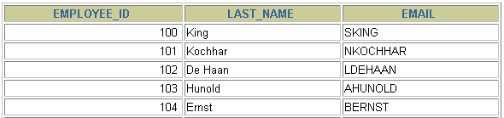
UNIQUE Constraint
UNIQUE constraint
EMPLOYEES
…
INSERT INTO
Allowed
Not allowed: already exists
Notes:
UNIQUE Constraint
A UNIQUE key integrity constraint requires that every value in a column or set of columns (key) be unique—that is, no two rows of a table can have duplicate values in a specified column or set of columns. The column (or set of columns) included in the definition of the UNIQUE key constraint is called the unique key. If the UNIQUE constraint comprises more than one column, that group of columns is called a composite unique key.
UNIQUE constraints enable the input of nulls unless you also define NOT NULL constraints for the same columns. In fact, any number of rows can include nulls for columns without NOT NULL constraints because nulls are not considered equal to anything. A null in a column (or in all columns of a composite UNIQUE key) always satisfies a UNIQUE constraint.
Note: Because of the search mechanism for UNIQUE constraints on more than one column, you cannot have identical values in the non-null columns of a partially null composite UNIQUE key constraint.

Slide 80
Table constraints
Sometimes, we need to put rules on a combination of our columns.
We can do this using TABLE constraints.
These go at the end of the table definition, before the final parenthesis ‘)’.
Typically, these are used:
To check column values against each other
To combine columns in a key.

Slide 81
DEFAULT Option
Specify a default value for a column during an insert if no value supplied by a user.
Literal values, expressions, or SQL functions are legal values.
Another column’s name or a pseudocolumn are illegal values.
The default data type must match the column data type.
... hire_date DATE DEFAULT SYSDATE, ...
CREATE TABLE hire_dates (id NUMBER(8),
hire_date DATE DEFAULT SYSDATE);
Table created.
Notes:
DEFAULT Option
When you define a table, you can specify that a column be given a default value by using the DEFAULT option. This option prevents null values from entering the columns if a row is inserted without a value for the column. The default value can be a literal, an expression, or a SQL function (such as SYSDATE or USER), but the value cannot be the name of another column or a pseudocolumn (such as NEXTVAL or CURRVAL). The default expression must match the data type of the column.
Note: CURRVAL and NEXTVAL are explained later in this lesson.

Slide 82
DEFAULT
CREATE TABLE books (
bookid NUMBER,
title VARCHAR2(50) NOT NULL UNIQUE,
author_last_name VARCHAR2(30) NOT NULL,
author_first_name VARCHAR2(30) NOT NULL,
rating NUMBER DEFAULT 1,
--Create primary key constraint for the books table
constraint book_pk primary key (bookid),
constraint rating_check CHECK (rating BETWEEN 1 and 10)
);

Slide 83
Overlapping constraints
A PRIMARY KEY constraint enforces:
NOT NULL
UNIQUE
You will get an error if you try to apply ‘NOT NULL’, ‘UNIQUE’ and ‘PRIMARY KEY’ as column constraints on the same column.
SQL Error: ORA-02259: duplicate UNIQUE/PRIMARY KEY specifications
02259. 00000 - "duplicate UNIQUE/PRIMARY KEY specifications"

Slide 84
Exercise
Create a table CAR table which has:
CarNo: should be numeric and will be the primary key
Manufacturer : should allow alphanumeric characters
YearsOld: numeric
Color: Alphanumeric
Kilometers: numeric
All fields are mandatory except Color.
The only acceptable values for Manufacturer are ‘HONDA’, ‘TOYOTA’, ‘NISSAN’
Hint: use in
The database must reject any row where the Kilometers is greater than 25000 * YearsOld

Slide 85
Exercise
Create an OWNER Table which has
OwnerID numeric and will be primary key
Oname: aphanumeric
Ophone: alphanumeric
DriversLicense: alphanumeric
Ophone is an optional field.

Slide 86
Exercise
Create an OWNER_CAR table which has
OwnerID(PK) (same as primary key on Owner table)
CarNo (PK) (same as primary key on Car table)
Price should be able to hold values up to 99999.99 and must have a value.
Primary key
Composite of OwenerID and CarNo
Foreign Keys
Relationship to Owner
Relationship to Car

Slide 87
If we violate a constraint… Duplicate Primary Key
Error report:
SQL Error: ORA-00001: unique constraint (DLAWLESS.SYS_C007393) violated
00001. 00000 - "unique constraint (%s.%s) violated"
*Cause: An UPDATE or INSERT statement attempted to insert a duplicate key.
For Trusted Oracle configured in DBMS MAC mode, you may see this message if a duplicate entry exists at a different level.
*Action: Either remove the unique restriction or do not insert the key.
INSERT INTO CLUB_MEMBER VALUES ( 654321, 'Y', 'Freddy', '13-Mar-78', 0, 'FRED@CLUB.IE', 0, '01-MAR-16' );
If a member with number 654321 already exists in the table….

Slide 88
Violating UNIQUE constraint on MEmail
Error report:
SQL Error: ORA-00001: unique constraint (DLAWLESS.SYS_C007394) violated
00001. 00000 - "unique constraint (%s.%s) violated"
*Cause: An UPDATE or INSERT statement attempted to insert a duplicate key.
For Trusted Oracle configured in DBMS MAC mode, you may see
this message if a duplicate entry exists at a different level.
*Action: Either remove the unique restriction or do not insert the key.
INSERT INTO CLUB_MEMBER VALUES ( 654322, 'Y', 'Freddy', '13-Mar-78', 0, 'FRED@CLUB.IE', 0, '01-MAR-09' );
If a member already exists with this email address ….

Slide 89
One that violates a ‘not null’
Error report:
SQL Error: ORA-01400: cannot insert NULL into ("DLAWLESS".“CLUB_MEMBER"."MCURRENT")
01400. 00000 - "cannot insert NULL into (%s)"
*Cause:
*Action:
insert into club_member (Mno, mname, mrenewdate) values (654325, 'Harry','01-JAN-1995');
To fix this :
insert into club_member (Mno, mcurrent,mname, mdateofbirth) values (654325, 'Y','Harry','01-JAN-1995');

Slide 90
Data Dictionary

Slide 91
SQL and the Data Dictionary
The data dictionary or catalogue stores
Information about database tables
Information about the columns of tables
Other information - users, locks, indexes, and more
This is ‘metadata’
Some DBMSs let you query the catalogue
In Oracle you can access the metadata in several ways
There are ‘system tables’ with metadata in them
You can also DESCRIBE tables

Slide 92
Oracle Data Dictionary
To find out what tables and sequences you have defined use
SELECT table_name
FROM user_tables
The user_tables table is maintained by Oracle
It has lots of columns, so don’t use
SELECT * FROM user_tables
To find the details of a table use
DESCRIBE <table name>

Slide 93
Oracle Data Dictionary
To find out what tables and sequences you have defined use
SELECT table_name
FROM user_tables
The user_tables table is maintained by Oracle
It has lots of columns, so don’t use
SELECT * FROM user_tables
To find the details of a table use
DESCRIBE <table name>

Slide 94
Oracle Data Dictionary
To find out what constraints you have defined
select * from user_constraints;

Slide 95
Handy way to delete all your tables…..
Type the following in the SQL Worksheet window:
create or replace procedure drpall as
begin
for i in (select * from tabs) loop
execute immediate ('drop table ' || i.table_name || ' cascade constraints');
end loop;
end drpall;
This will create a procedure (this will be listed under the Procedures in your connection)

Slide 96
Handy way to delete all your tables…..
To run your procedure
In SQL worksheet
Execute DRPALL;
(this is case sensitive)

